Slide 1
Crisis & Suicide Prevention Promotional materials
Please email Casey Muckler with contact information (name, email, phone number, and physical address) and which items you would like.
Casey.Muckler@dmh.mo.gov

Slide 2
Crisis Text Line

Slide 3
Water bottle
Notes:
Total Quantity Ordered: 5,000

Slide 4
Pens
Notes:
Total Quantity Ordered: 15,000

Slide 5
Hats – Not yet available
On backorder, TBD
Notes:
Total Quantity Ordered: 1,000

Slide 6
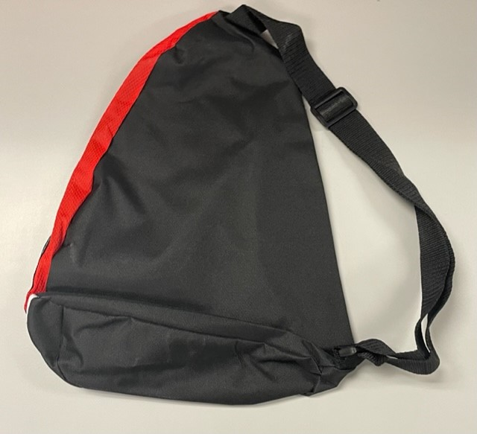
Bags – Limited Quantity
Notes:
Total Quantity Ordered: 2,000

Slide 7
Stickers – Limited Quantity
Notes:
Total Quantity Ordered: 5,000

Slide 8
Posters – Crisis Text Line
Notes:
Total Quantity Ordered: 2,000

Slide 9
Posters – Crisis Text Line
Notes:
Total Quantity Ordered: 2,000

Slide 10
Posters – Crisis Text Line
Notes:
Total Quantity Ordered: 2,000

Slide 11
Posters – Crisis Text Line
Notes:
Total Quantity Ordered: 2,000

Slide 12
Posters – Crisis Text Line
Notes:
Total Quantity Ordered: 2,000

Slide 13
Help Him Stay Suicide Prevention

Slide 14
Posters – Help Him Stay

Slide 15
Posters – Help Him Stay

Slide 16
Posters – Help Him Stay

Slide 17
Posters – Help Him Stay

Slide 18
Posters – Help Him Stay

Slide 19
Posters – Help Him Stay

Slide 20
Posters – Help Him Stay

Slide 21
Posters – Help Him Stay

Slide 22
Posters – Help Him Stay

Slide 23
Posters – Help Him Stay

Slide 24
Posters – Help Him Stay

Slide 25
Posters – Help Him Stay

Slide 26
National Suicide Prevention Lifeline Yard Sign – Limited Quantity

